Slide 1
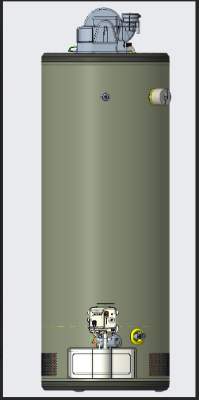
Power Vent Water Heater - Flammable Vapor Sensor Location Performance
FV Sensor

Slide 2
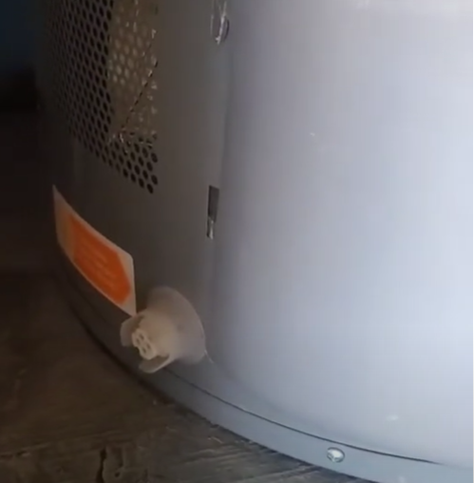
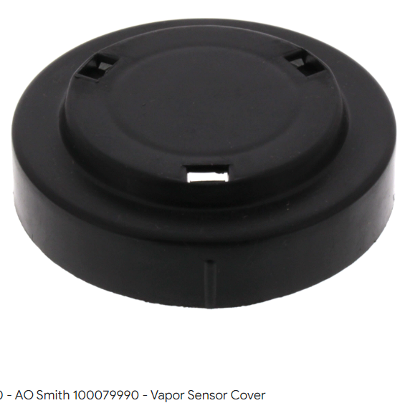
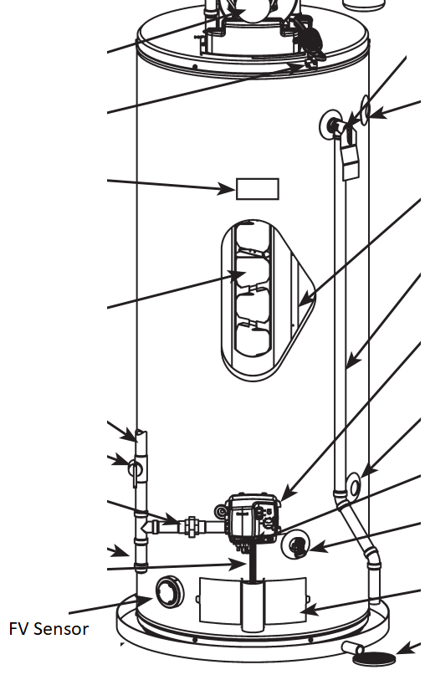
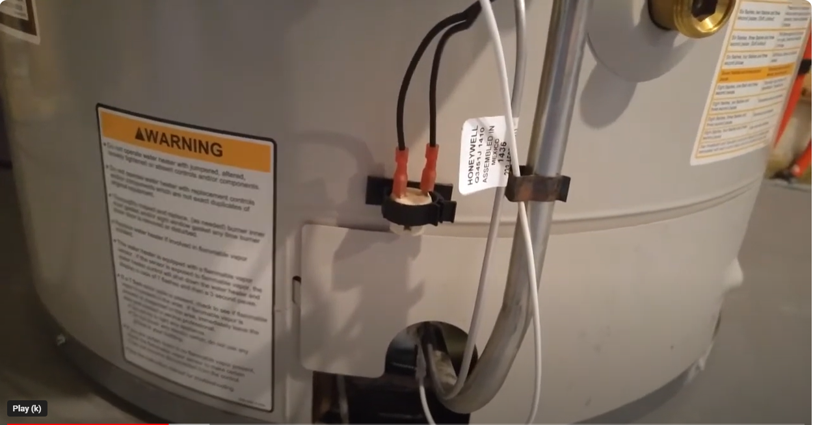
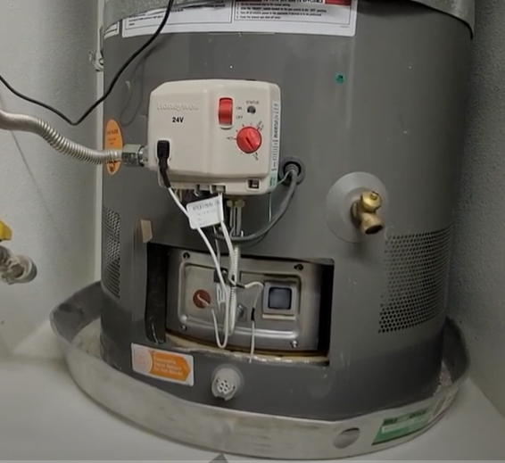
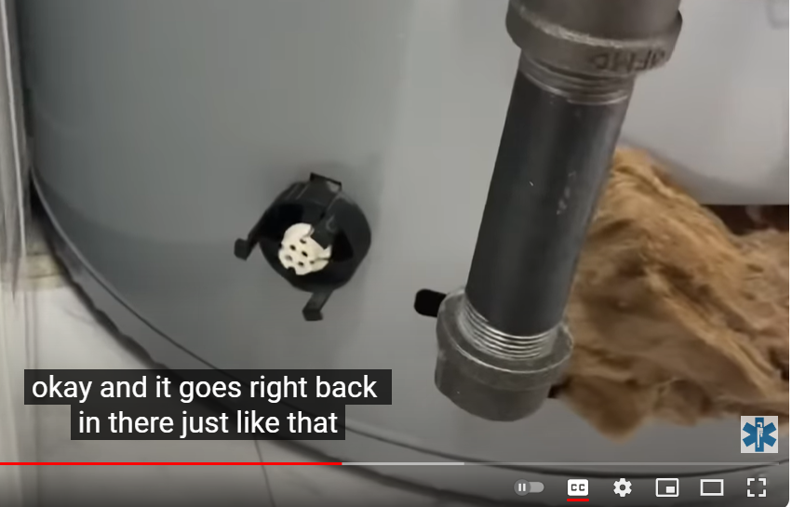
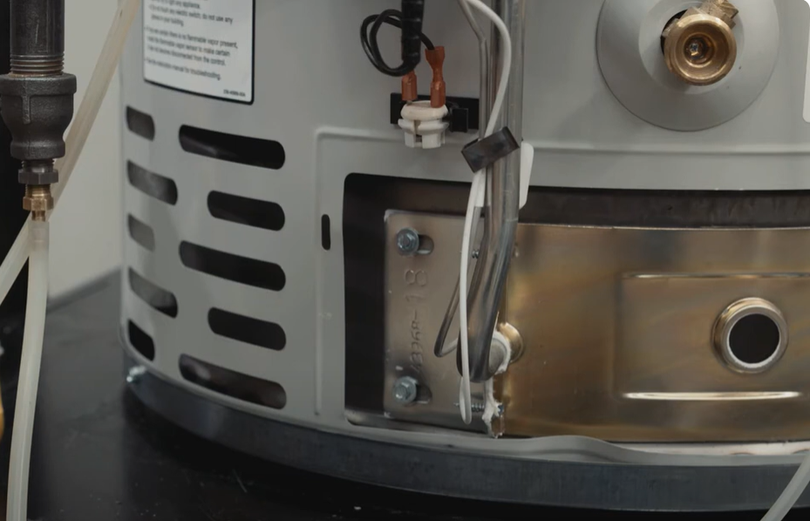
Notice all are “Factory Set” permanent locations
AO Smith
Rheem (Has different locations based on model)
Bradford White
(not in convection path)

Slide 3
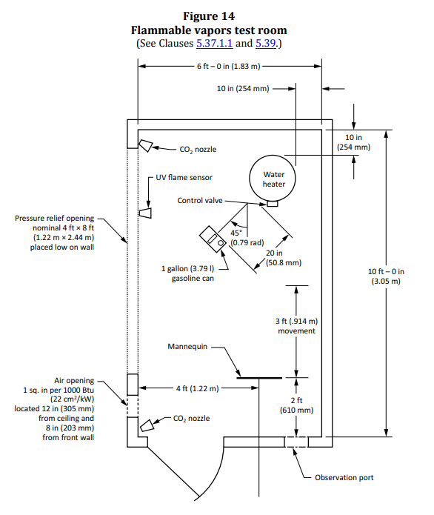
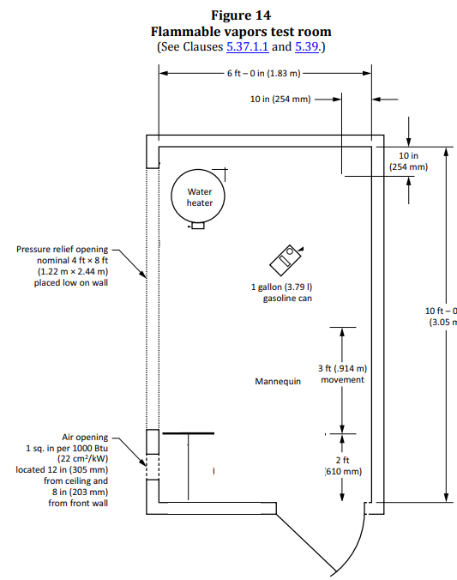
Understanding the test
Standard allows for placement on both side of room.
GEA and CSA Room Setup
Per the ANSI Standard

Slide 4
Good performance
Results can vary depending on test setup. A symmetric low placement is more ideal
Good performance
Reduced performance
Core Spill Area
If the sensor is directly in front of spill (splash zone), it trips almost immediately.

Slide 5
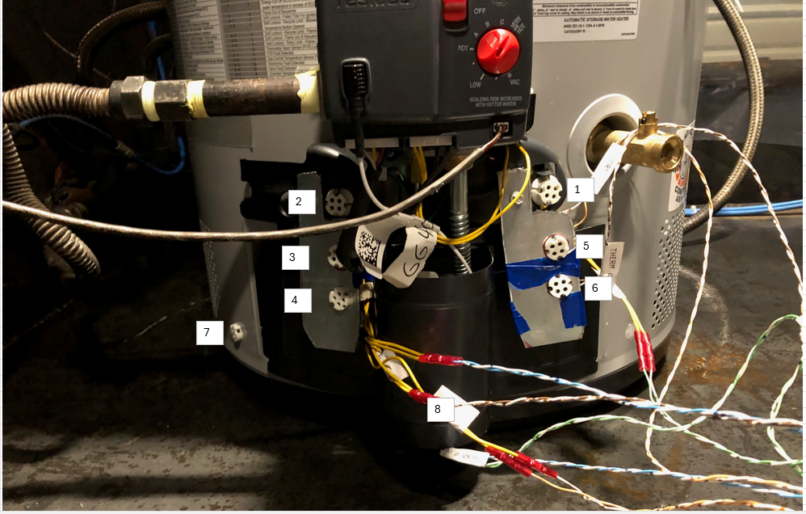
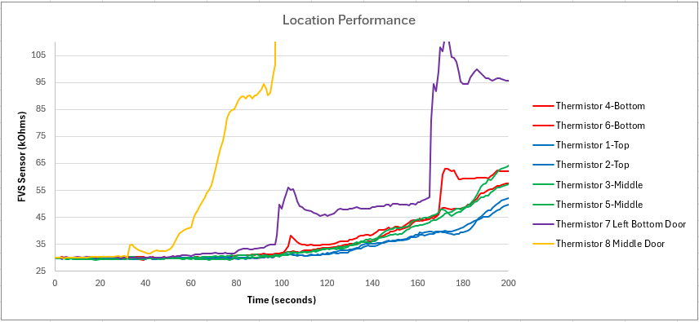
Performance is location based. This goes for:
Linear distance from core spill area
Height from core spill area.
Performance is less responsive the further away from core spill area you are.
Note: Gasoline evaporation rates are temperature dependent. Higher temperature, higher evaporation rate
Colors are grouped by general location area.
All resistance values have been normalized

Slide 6
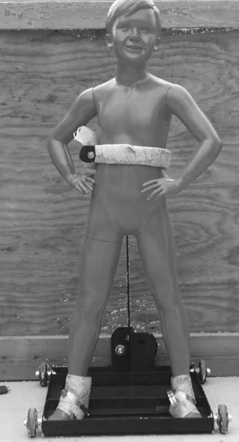
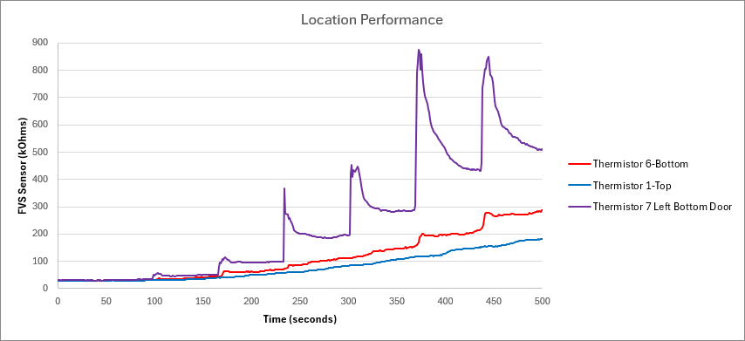
Sensor Performance vs Air Circulation
As the height distance from the source increases, the mannequin's influence on "stirring air" decreases the sensor's sensitivity.
This is the mannequin’s movement. It occurs every 60 seconds.
Thermistor 7 = Closest to floor
Thermistor 1 = Furthest from floor

Slide 7
Sensor Performance vs Air Circulation
We are most interested in performance below 3 minutes

Slide 8
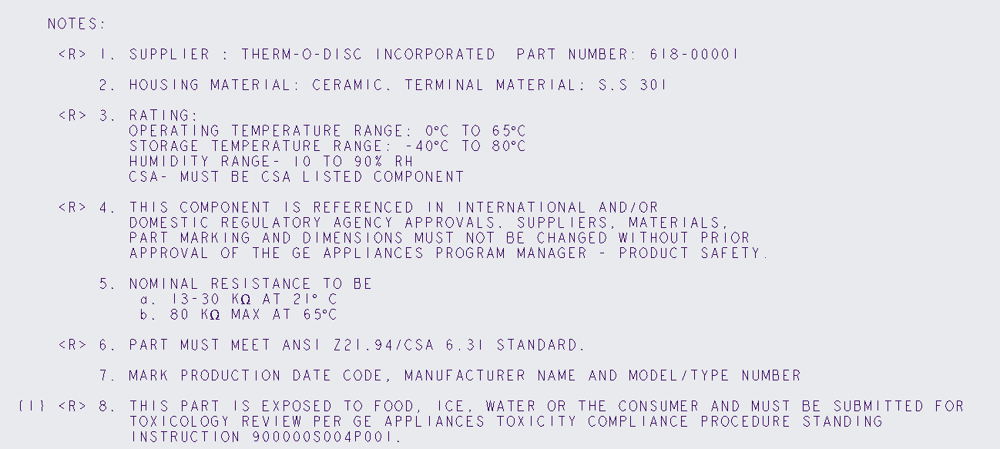
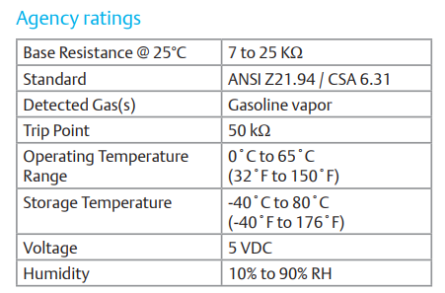
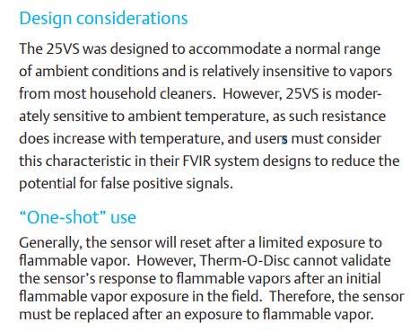
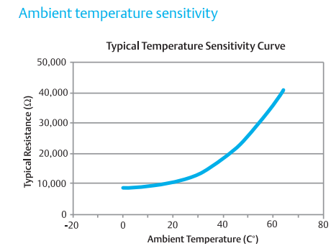
Understanding TOD 25VS – TOD Datasheet
Our print requires 13-30 kOhm at 21°C (69.8°F). Range of 17 kOhms
Due to ambient temperature sensitivity, production line checks/quality will require temperature compensation

Slide 9
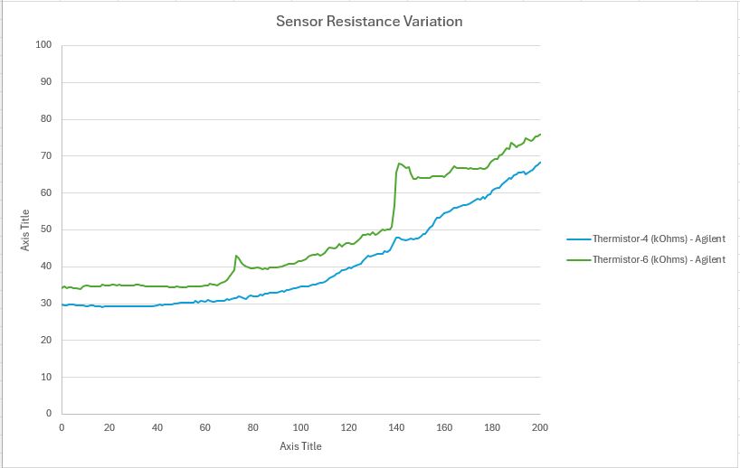
Understanding TOD 25VS – kOhm Differences
~135 seconds to 50 kOhms
~150 seconds to 50 kOhms
Notice that the sensor will track based on its initial performance. So, a low sensor will stay low and vise versa
This mean that a low sensor will take a slightly longer time to hit the trip point.
Measured at this location

Slide 10
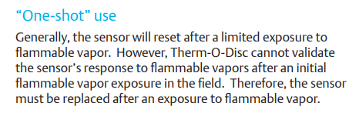
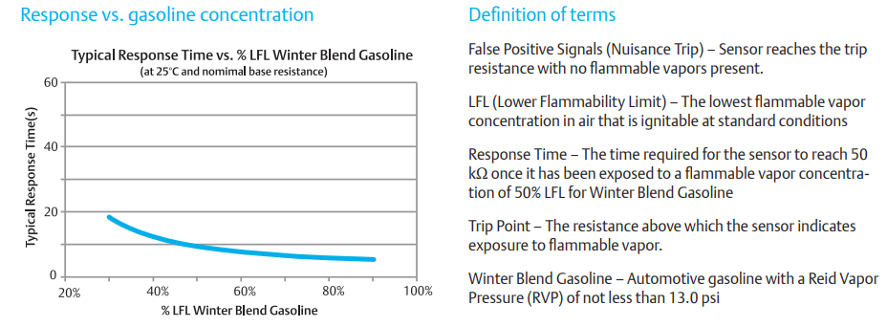
Understanding TOD 25VS – Response Time
Notice that the sensor has a “Typical Response time”. This will need to be quantified within our print limits.
Once we verify limits, we can verify margin

Slide 11
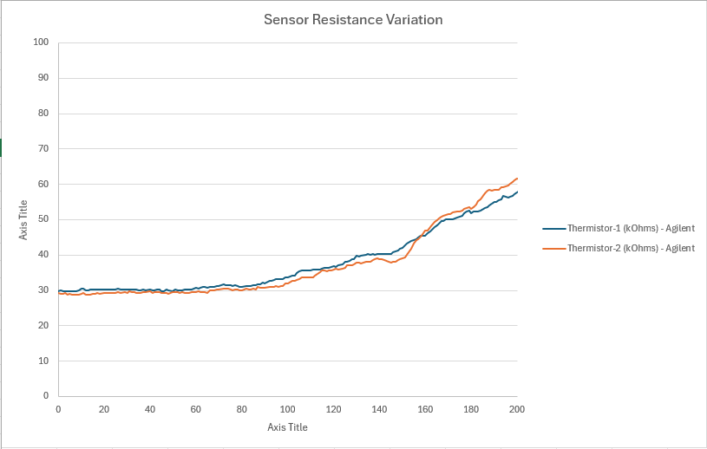
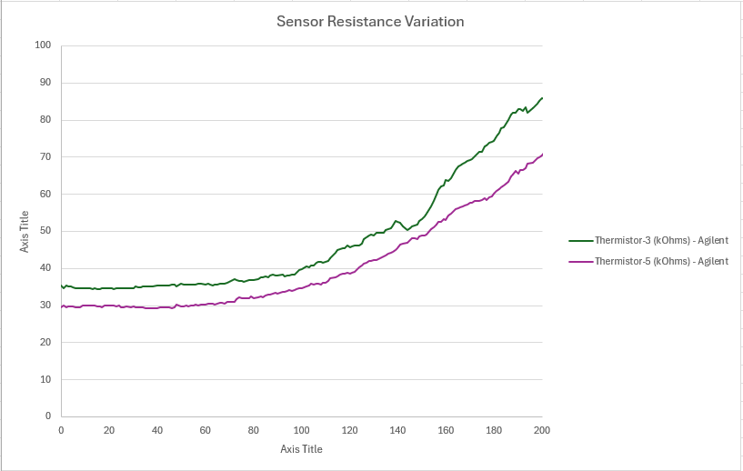
Understanding TOD 25VS
Each sensor can read slightly different (15-30 kOhms). Notice how it tracks after the spill. If it starts with a lower value, it will ultimately take longer to trip.

Slide 12
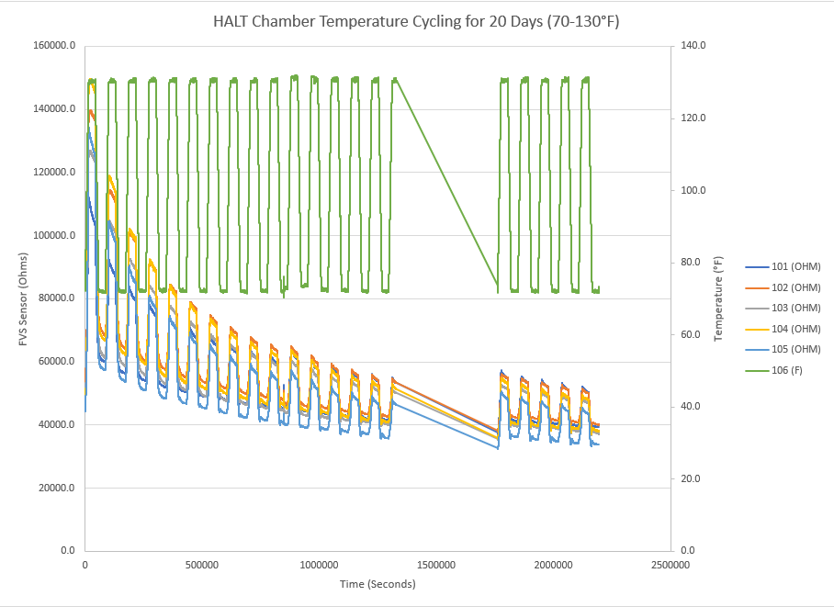
Sensor Performance vs Air Temperature
Action Item: Run temperature cycled sensor in FV Chamber Test.
Goal:
Try to avoid areas that see temperature cycling, such as top of combustion chamber door (convection). Bottom below outer door could be ok, similar to Rheem.
More to come on this. We need to better understand if the “settling” corresponds to VOC performance.

Slide 13
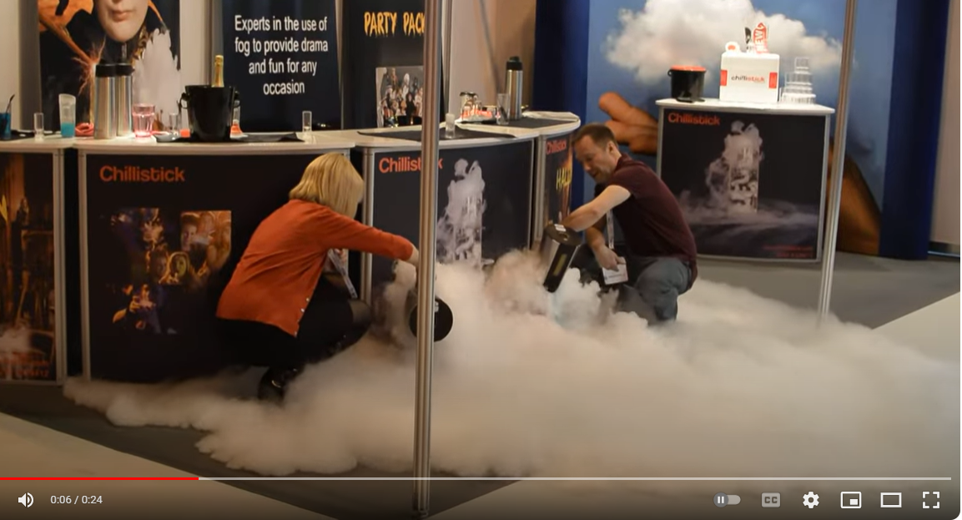
Understanding the spill
Example using dry ice (CO2). CO2 is heavier than air, therefore, it tends to spread outwards
CO2 Density = 1.53 times that of air
Butane Density = 2.1 times that of air

Slide 14
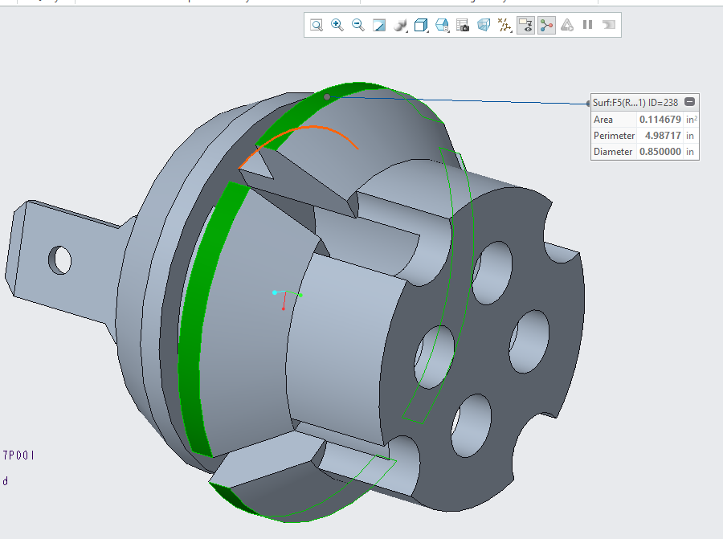
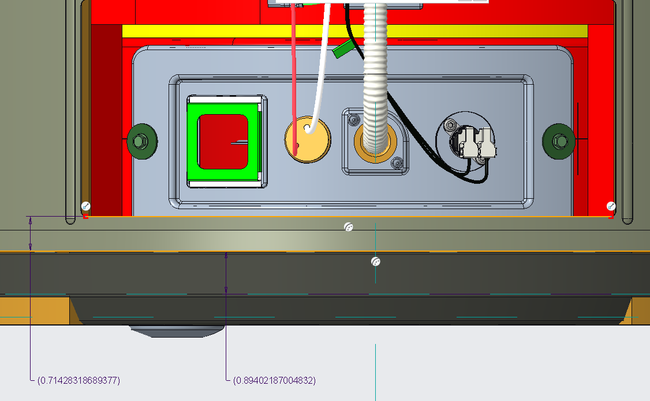
Potential Locations
Maybe..but would have to look at shipping/user damage.
Due to space limitations, would probably be snap on/glue on. Its also very close to packaging EPS

Slide 15
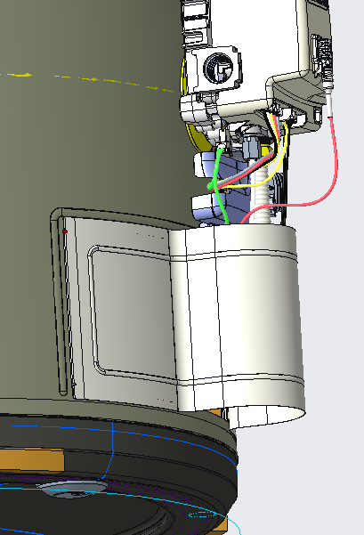
Potential Locations
Maybe. User Installed/Removable

Slide 16
Very similar to competitive approaches. Current tooling already has this hole. Shielded from combustion chamber temperature cycling.
Location 7 Performance:
Core Spill Area - Improved
Opposite Side - Improved
Proposed Location
Mannequin Push
Current Location

Slide 17
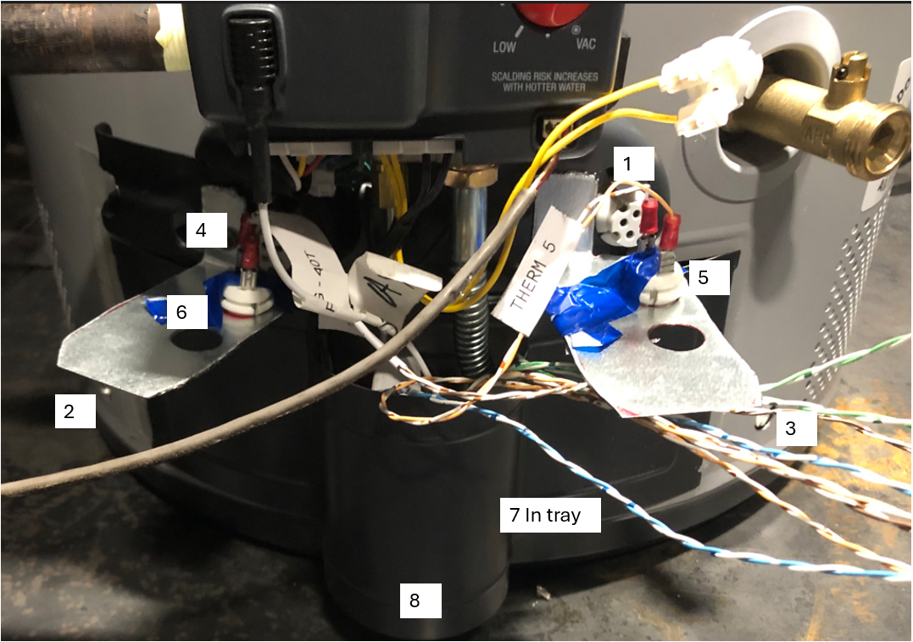
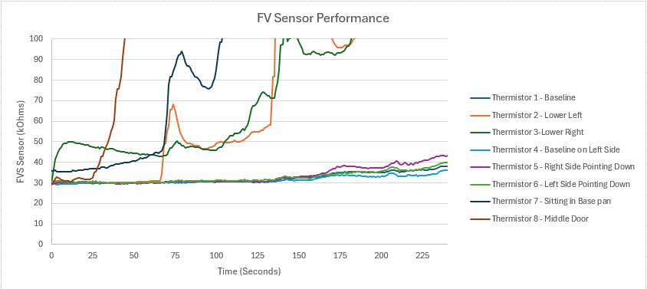
Lower Left & Right
Baseline

Slide 18
Valve Software Operation.
If the system is in RUN mode and the Flame Vapor Sensor (FVS) exceeds 100k, it shuts off the burner and waits for the FVS to drop below 80k within 30 seconds.
If the FVS drops below 80k within 30 seconds, the system goes back to idle and restarts.
If the FVS does not drop below 80k within 30 seconds, the system enters a hard lockout requiring a manual reset.
The 30-second interval where it is "Waiting" is considered a Soft Lock. After 30 seconds, if the FVS has not dropped below 80k, it becomes a Hard Lock, requiring a manual reset.
This process applies regardless of the current mode (e.g., IDLE, prepurge, postpurge), as long as the control is not already in a lockout state. If the FVS exceeds 100k in any mode, it follows the same routine:
Soft Lock for 30 seconds.
Hard Lock if the FVS does not drop below 80k within 30 seconds.

Slide 19
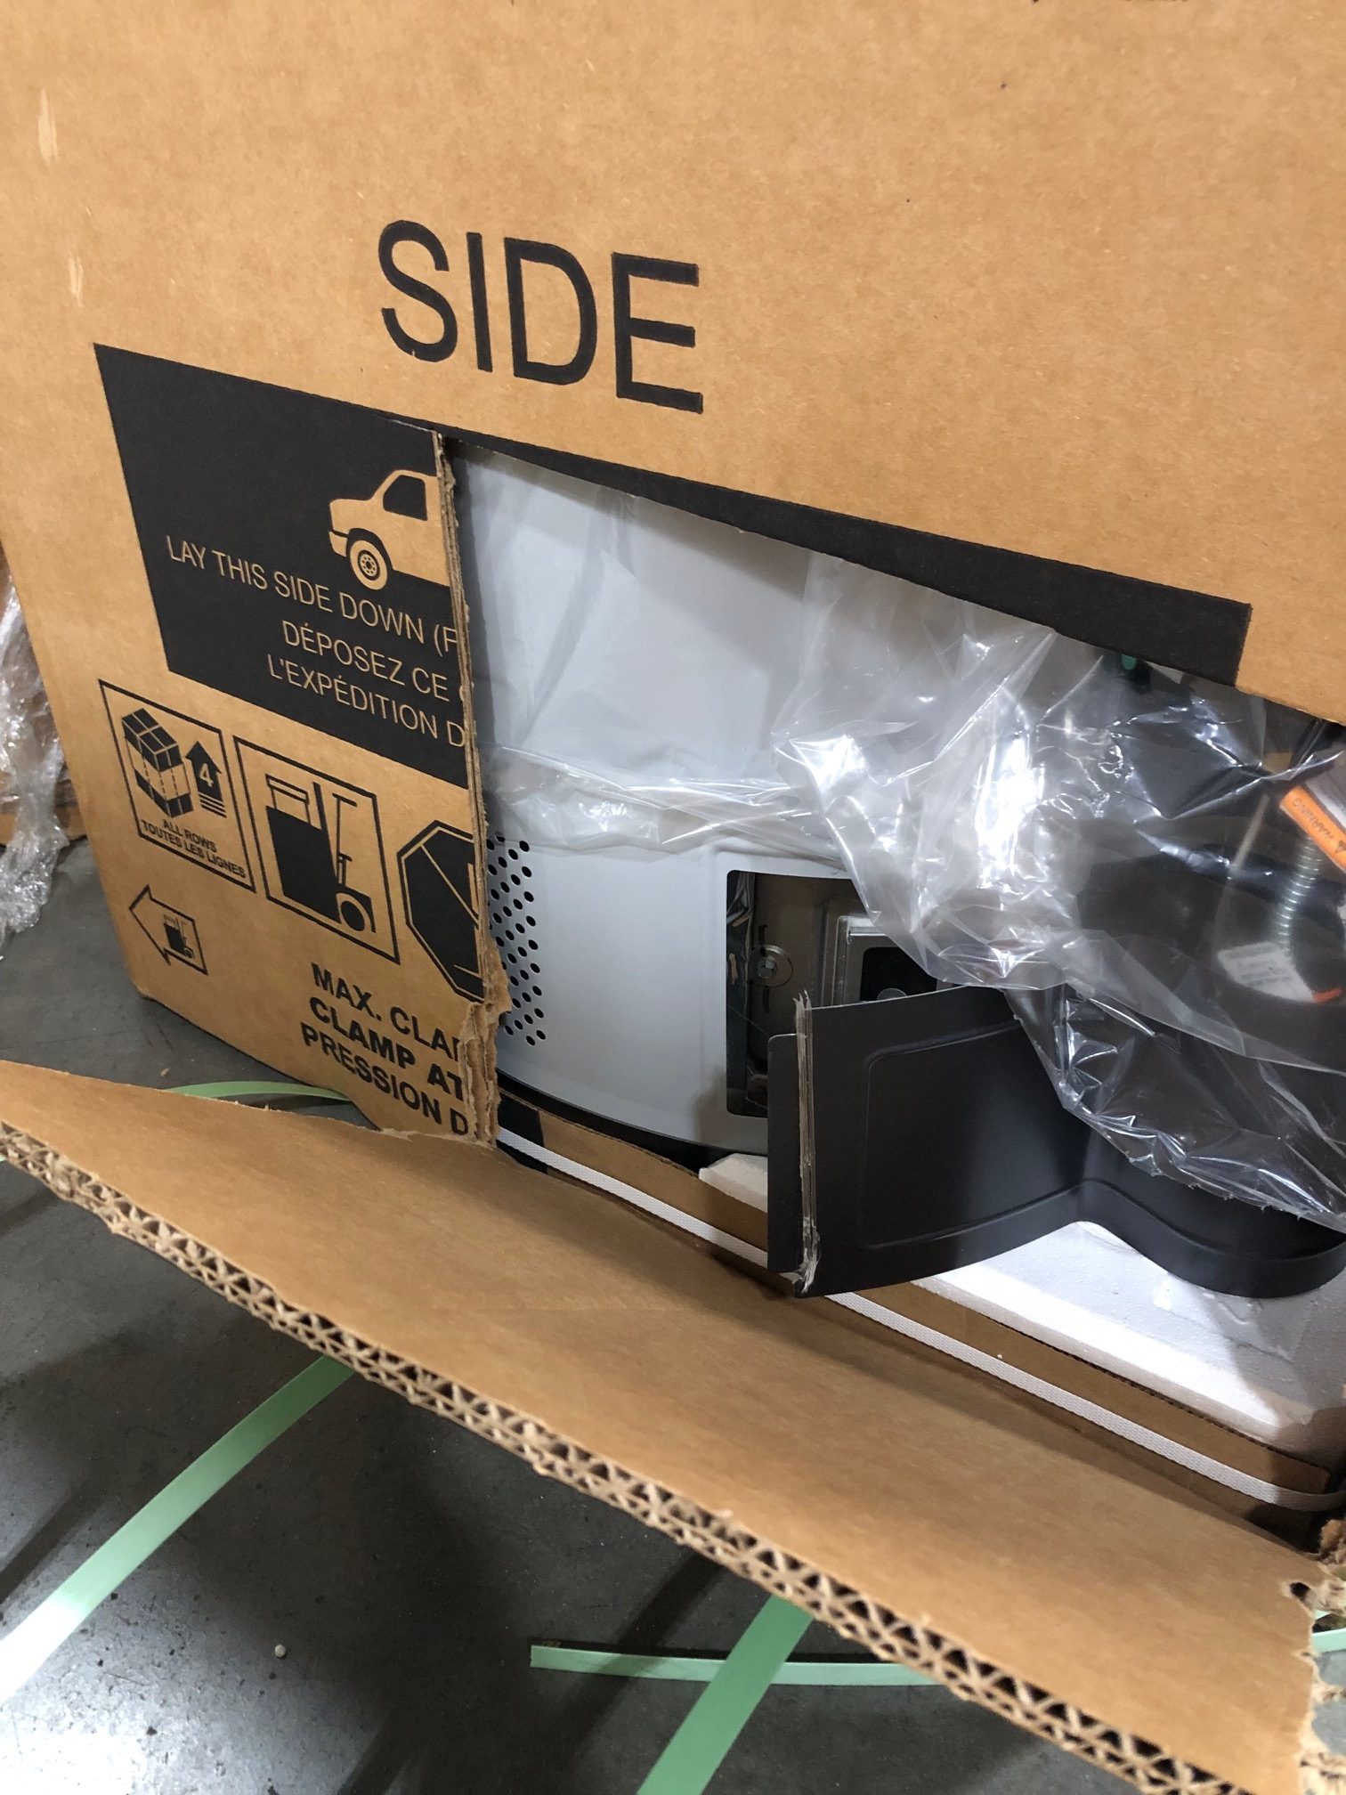
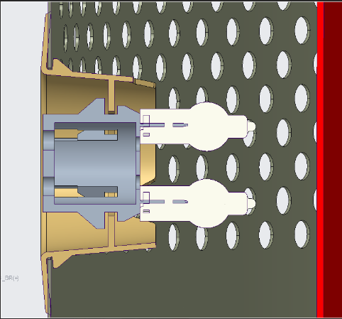
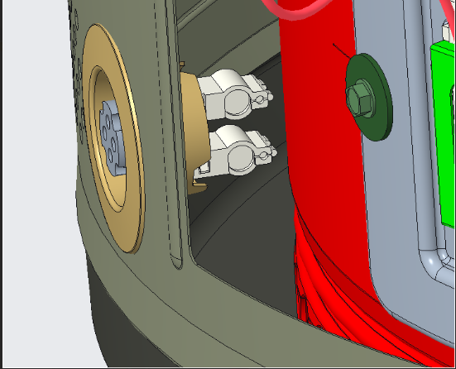
Packaging
Due to packaging and clamp handling.
The FVS Bracket holder will need to be recessed.

